Slide 1
Unit-II Object Oriented Analysis

Slide 2
Why Analysis
To capture a complete, unambiguous and consistent picture of requirement of system and what the system must to do to satisfy the user’s requirements and needs.

Slide 3
Analysis tools
Examination of exiting system
Interviews
Questionnaires
Observations

Slide 4
Difficulties
1.Fuzzy description
2.Incmplete requirement
3.Unnecessary feature

Slide 5
-Business object analysis
-Use case Driven

Slide 6
Using Use Case Diagrams
Use case diagrams are used to visualize, specify, construct, and document the (intended) behavior of the system, during requirements capture and analysis.
Provide a way for developers, domain experts and end-users to Communicate.
Serve as basis for testing.
Use case diagrams contain use cases, actors, and their relationships.

Slide 7
Use case modelling
Use case modelling is a form of requirements engineering
Use case modelling proceeds as follows:
Find the system boundary
Find actors
Find use cases
Use case specification
Scenarios
Identify the system boundary, who or what uses the system, and what functions the system should offer

Slide 8
The subject (System Bounary)
Before we can build anything, we need to know:
Where the boundary of the system lies
Who or what uses the system
What functions the system should offer to its users
We create a Use Case model containing:
Subject – the edge of the system
also known as the system boundary
Actors – who or what uses the system
Use Cases – things actors do with the system
Relationships - between actors and use cases
subject
SystemName

Slide 9
Use case Model
1.System Boundary
2.Actor
3.Use case
4.Relationship

Slide 10
System Boundary
The system boundary is defined by who or what uses the system (i.e. the actors), and what specific benefits the system offers to those actors (i.e. the use cases).
The system boundary is drawn as a box, labeled with the name of the system, with the actors drawn outside the boundary and the use cases inside.

Slide 11
POST: Point of Sale Terminal
Use Case
System Boundary
POST
Buy Item
Log In
Cashier
Customer
Refund a Purchased Item

Slide 12
What are actors?
An actor is anything that interacts directly with the system
Actors identify who or what uses the system and so indicate where the system boundary lies
Actors are external to the system
An Actor specifies a role that some external entity adopts when interacting with the system
«actor»
Customer
Customer

Slide 13
Actors
name
An external objects that interact directly with the system.
An actor represents a set of roles that users of use case play when interacting with these use cases.
Actors can be human or automated systems.
Actors are entities which require help from the system to perform their task or are needed to execute the system’s functions.
Actors are not part of the system.

Slide 14
Finding Actor
Who will use the main functionality of the system?
Who will need support from the system to do their daily tasks?
Who will need to maintain and administer the system, and keep it working?
Which hardware device does the system need handle?
Ex: Person , device, other system –anything that interact directly to system

Slide 15
Identifying Actors
When identifying actors ask:
Who or what uses the system?
What roles do they play in the interaction?
Who installs the system?
Who starts and shuts down the system?
Who maintains the system?
What other systems use this system?
Who gets and provides information to the system?
Does anything happen at a fixed time?
Time

Slide 16
In terms of modeling actors, remember the following points.
-Actors are always external to the system – they are therefore outside your control.
- Actors interact directly with the system – this is how they help to define the system boundary.
-Actors represent roles that people and things play in relation to the system, not specific people or specific things.

Slide 17
-One person or thing may play many roles in relation to the system simultaneously or over time.
-For example, if you were both writing
and delivering training courses, from the perspective of a course planning system you would play two roles – “Trainer” and “Course
Author”.
-Each actor needs a short name that makes sense from the business perspective.

Slide 18
What are use cases?
A use case describes behavior that the system exhibits to benefit one
or more actors.
A use case is something an actor needs the system to do. It is a “case of use” of the system by a specific actor
Use cases are always started by an actor
The primary actor triggers the use case
Zero or more secondary actors interact with the use case in some way
Use cases are always written from the point of view of the actors
PlaceOrder
GetStatusOnOrder

Slide 19
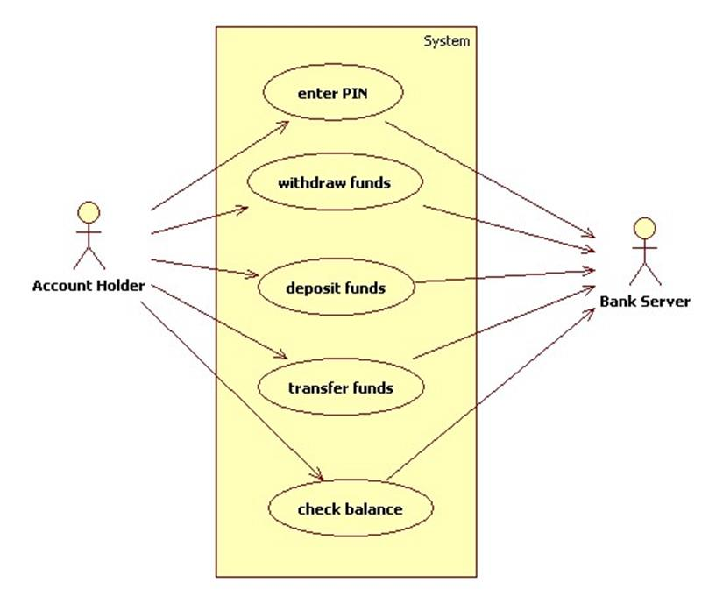

Slide 20
Use Case
name
Use cases specify desired behavior.
A use case is a description of a set of sequences of actions, including variants, a system performs to yield an observable result of value to an actor.
Each sequence represent an interaction of actors with the system.

Slide 21
To find use cases ask “How does each actor use the system?” and “What does the system do for each actor?”

Slide 22
Identifying use cases
Start with the list of actors that interact with the system
When identifying use cases ask:
What functions will a specific actor want from the system?
Does the system store and retrieve information? If so, which actors trigger this behaviour?
Are any actors notified when the system changes state?
Are there any external events that affect the system? What notifies the system about those events?

Slide 23
Use Cases and Actors
From the perspective of a given actor, a use case does something that is of value to the actor, such as calculate a result or change the state of an object.
The Actors define the environments in which the system lives

Slide 24
The use case diagram
Mail Order System use case diagram
Mail Order System
subject name
communication relationship
system boundary
Place Order
Cancel Order
Ship
Product
ShippingCompany
Check Order
Status
Customer
Send
Catalogue
actor
use case
Dispatcher

Slide 25
Example of Use Case Diagram
registration
updating
grades
student
faculty
output
generating

Slide 26
Relationships (Use case)
Relationships :
Actor generalisation-between actors
Use case generalisation- between use cases
Association (between actor and use case)
«include» – between use cases
«extend» – between use cases

Slide 27
Relationships between Actors
Generalization.
student
graduate
student
non-graduate
student

Slide 28
Actor generalization - example
The Customer and the Sales Agent actors are very similar
They both interact with List products, Order products, Accept payment
Additionally, the Sales Agent interacts with Calculate commission
Our diagram is a mess – can we simplify it?
Sales system
ListProducts
Customer
OrderProducts
AcceptPayment
CalculateCommission
SalesAgent

Slide 29
Actor generalisation
abstract actor
If two actors communicate with the same set of use cases in the same way, then we can express this as a generalisation to another (possibly abstract) actor
The descendent actors inherit the roles and relationships to use cases held by the ancestor actor
Sales system
ancestor or parent
ListProducts
generalisation
Purchaser
OrderProducts
AcceptPayment
CalculateCommission
Customer
SalesAgent
descendents or children
Use actor generalization when it simplifies the model

Slide 30
Relationships between Use Cases and Actors
Actors may be connected to use cases by associations, indicating that the actor and the use case communicate with one another using messages.
updating
grades
faculty

Slide 31
Relationships between Use Cases
1. Generalization - use cases that are specialized versions of other use cases.
2. Include - use cases that are included as parts of other use cases. Enable to factor common behavior.
3. Extend - use cases that extend the behavior of other core use cases. Enable to factor variants.

Slide 32
1.Use case generalisation
The ancestor use case must be a more general case of one or more descendant use cases
Child use cases are more specific forms of their parent
They can inherit, add and override features of their parent
Sales system
FindProduct
Customer
FindBook
FindCD

Slide 33
Generalization
The child use case inherits the
behavior and meaning of the
parent use case.
The child may add to or
override the behavior of its parent.
parent
child

Slide 34
Example- Generalization
registration
non-graduate
registration
graduate
registration

Slide 35
2. «include»
The client use case(base use case) executes until the point of inclusion: include(SupplierUseCase)
Control passes to the supplier use case which executes
When the supplier is finished, control passes back to the client use case which finishes execution
Note:
Client use cases are not complete without the included supplier use cases
Supplier use cases may be complete use cases, or they may just specify a fragment of behaviour for inclusion elsewhere
Personnel System
client
Change Employee
Details
stereotype
«include»
View Employee
Details
«include»
Find Employee
Details
Manager
«include»
Delete Employee
Details
supplier
dependency relationship
When use cases share common behaviour we can factor this out into a separate supplier use case and «include» it in the clients

Slide 36
«include» example
Use case: ChangeEmployeeDetails
Use case: FindEmployeeDetails
ID: 1
ID: 4
Brief description:
The Manager changes the employee details.
Brief description:
The Manager finds the employee details.
Primary actors:
Manager
Primary actors:
Manager
Seconday actors:
None
Seconday actors:
None
Preconditions:
1. The Manager is logged on to the system.
Preconditions:
1. The Manager is logged on to the system.
Main flow:
Main flow:
1.
2.
3.
include( FindEmployeeDetails ).
The system displays the employee details.
The Manager changes the employee details.
…
1.
2.
The Manager enters the employee's ID.
The system finds the employee details.
Postconditions:
1. The system has found the employee details.
Postconditions:
1. The employee details have been changed.
Alternative flows:
None.
Alternative flows:
None.

Slide 37
2. Include
<<include>>
The base use case explicitly incorporates the behavior of another use case at a location specified in the base.
base
included

Slide 38
More about Include
Enables to avoid describing the same flow of events several times by putting the common behavior in a use case of its own.
updating
grades
<<include>>
verifying
student id
output
generating
<<include>>

Slide 39
3.«extend»
«extend» is a way of adding new behaviour into the base use case by inserting behaviour from one or more extension use cases
The base use case specifies one or more extension points in its flow of events
The extension use case may contain several insertion segments
The «extend» relationship may specify which of the base use case extension points it is extending
Library system
base use case
Return book
stereotype
«extend»
Borrow book
Issue fine
Librarian
dependency relationship
Find book
extension use case
The base use case provides extension points, but does not know about the extensions.

Slide 40
3. Extend
base
<<extend>>
extending
The base use case implicitly incorporates the behavior of another use case at certain points called extension points.
The base use case may stand alone, but under certain conditions its behavior may be extended by the behavior of another use case.

Slide 41
Base use case
Use case: ReturnBook
ID: 9
base use case
Brief description:
The Librarian returns a borrowed book.
ReturnBook
Primary actors:
Librarian
extension points
overdueBook
Secondary actors:
None.
Preconditions:
1. The Librarian is logged on to the system.
extension point: overdueBook
Main flow:
1.
2.
3.
4.
«extend»
The Librarian enters the borrower's ID number.
The system displays the borrower's details including the list of borrowed books.
The Librarian finds the book to be returned in the list of books.
The Librarian returns the book.
…
extension
point
extension
point name
extension point: overdueBook
IssueFine
Postconditions:
1. The book has been returned.
Alternative flows:
None.
extension use case
There is an extension point overdueBook just before step 3 of the flow of events
Extension points are not numbered, as they are not part of the flow

Slide 42
Extension use case
Extension Use case: IssueFine
ReturnBook
ID: 10
extension points
overdueBook
Brief description:
Segment 1: The Librarian records and prints out a fine.
Primary actors:
Librarian
extension point: overdueBook
Secondary actors:
None.
«extend»
Segment 1 preconditions:
1. The returned book is overdue.
the single insertion segment
in IssueFine is inserted at the overdueBook insertion point in the ReturnBook use case
Segment 1 flow:
1.
2.
The Librarian enters details of the fine into the system.
The system prints out the fine.
IssueFine
Segment 1 postconditions:
1. The fine has been recorded in the system.
2. The system has printed out the fine.
Extension use cases have one or more insertion segments which are behaviour fragments that will be inserted at the specified extension points in the base use case

Slide 43
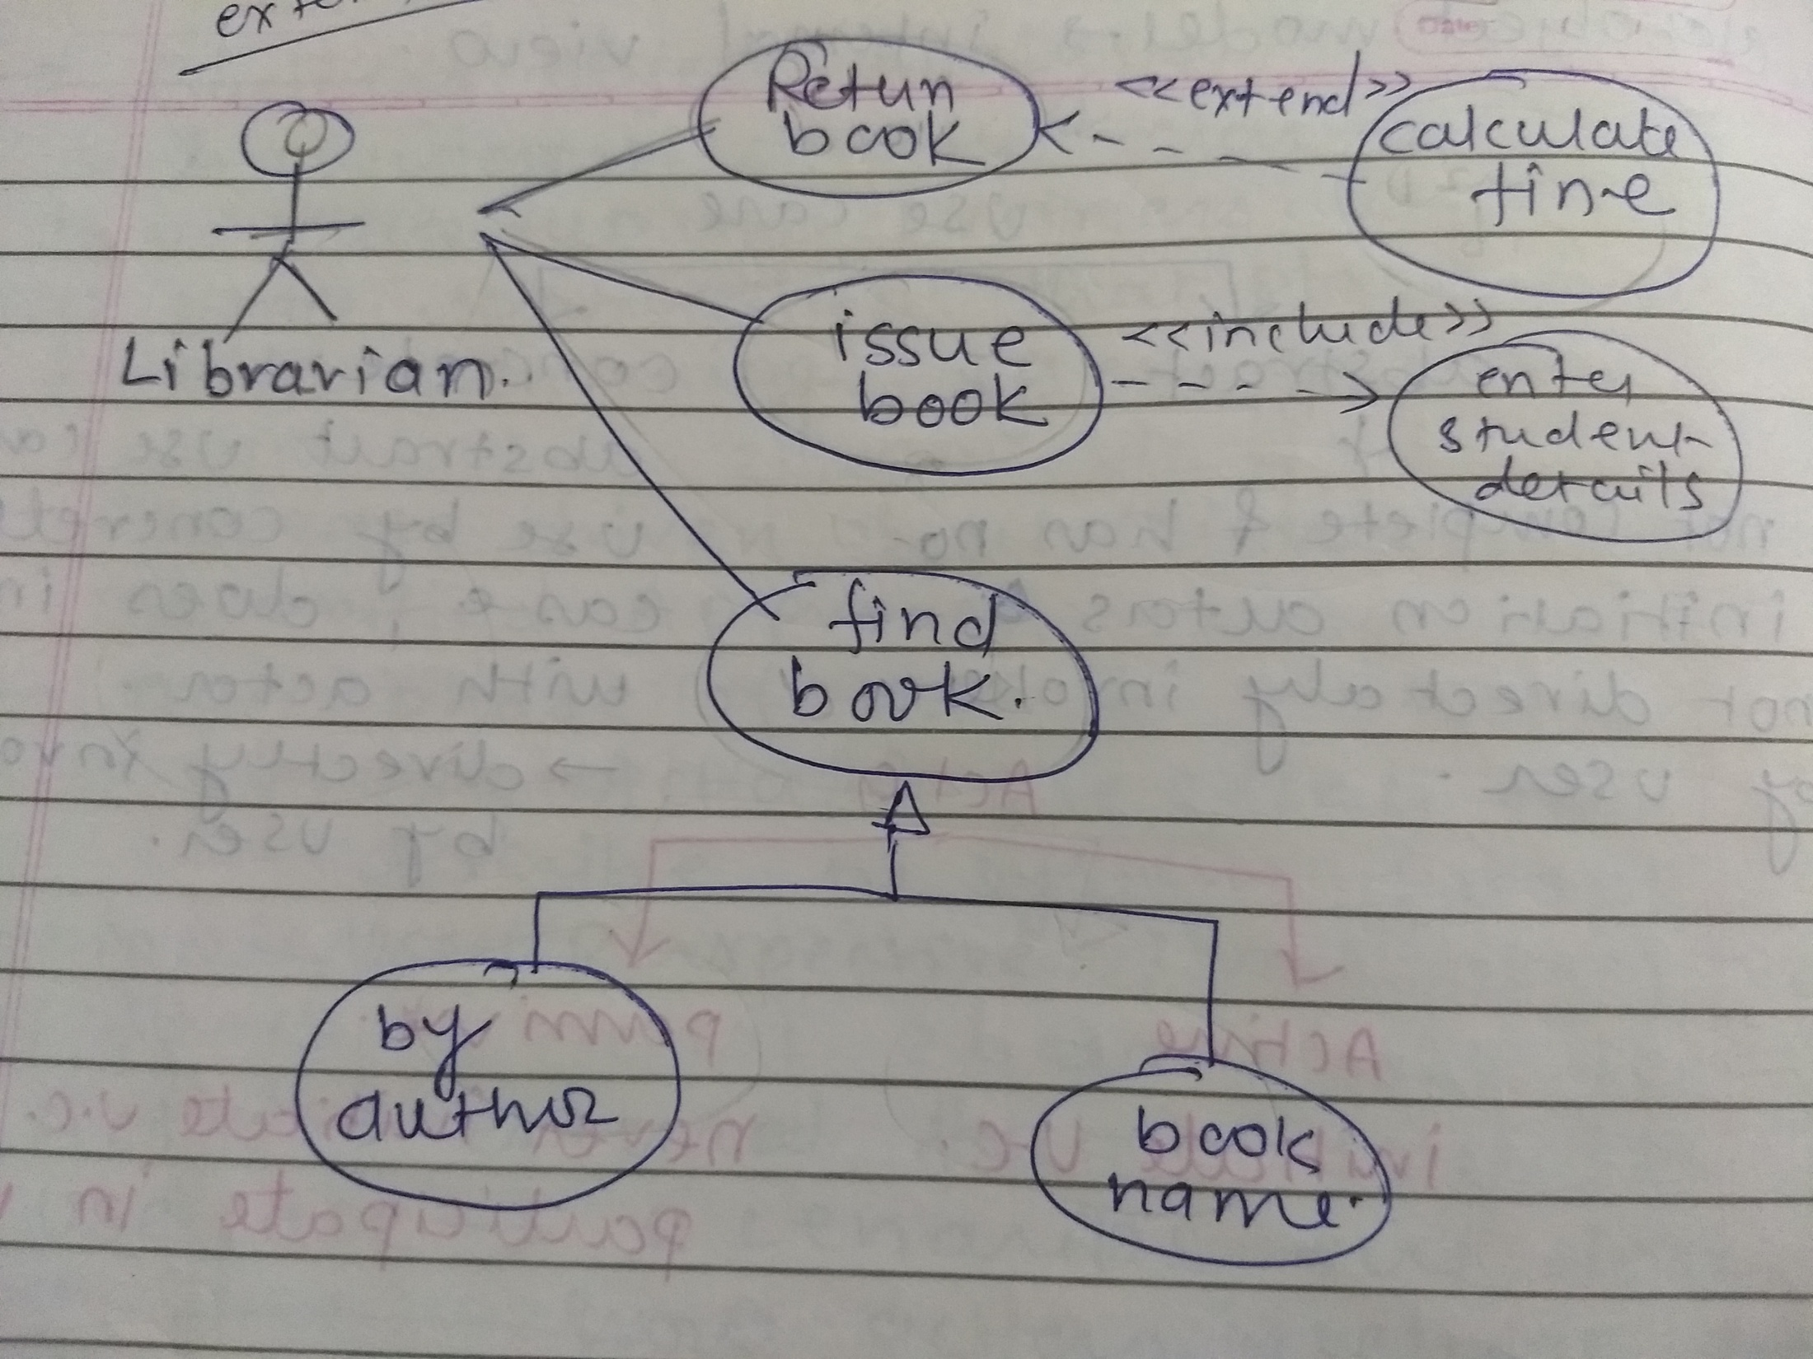
More about Extend
Enables to model optional behavior or branching under conditions.
<<extend>>
Exam-grade appeal
Exam copy request

Slide 44
Example
place
conference call
place
phone call
<<extend>>
cellular
network
receive
additional call
receive
phone call
<<extend>>
use
scheduler
user
Cellular Telephone

Slide 45
A More Complicate Example

Slide 46
Specifying the Behavior of a Use Case
Describing the flow of events within the use case.
Can be done in natural language, formal language or pseudo-code.
Includes: how and when the use case starts and ends; when the use case interacts with actors and what objects are exchanged; the basic flow and alternative flows of the behavior.

Slide 47
Use Case Description
Each use case may include all or part of the following:
Title or Reference Name - meaningful name of the UC
Author/Date - the author of the UC and its creation date
Modification/Date - last modification to the UC and its date
Purpose - specifies the goal to be achieved by the UC
Overview - short description of the use cases processes
Cross References - requirements references
Actors - agents which initiate or participate in the UC
Pre Conditions - must be true to allow the execution of the UC
Post Conditions - will be set when the use use completes its execution normally
Normal flow of events - regular flow of activities of the UC
Alternative flow of events - other flow of activities of the UC
Exceptional flow of events - unusual situations
Implementation issues - possible foreseen problems in the implementation of the UC
Each use case may include all or part of the following:
Title or Reference Name - meaningful name of the UC
Author/Date - the author and creation date
Modification/Date - last modification and its date
Purpose - specifies the goal to be achieved
Overview - short description of the processes
Cross References - requirements references
Actors - agents participating
Pre Conditions - must be true to allow execution
Post Conditions - will be set when completes normally
Normal flow of events - regular flow of activities
Alternative flow of events - other flow of activities
Exceptional flow of events - unusual situations
Implementation issues - foreseen implementation problems

Slide 48
Each use case has a name and a specification. The specification consists of:
Preconditions – these are things that must be true before the use case can execute – they are constraints on the state of the system;
Flow of events – the steps in the use case;
Postconditions – things that must be true at the end of the use case.

Slide 49
Use case specification
use case name
Use case: PaySalesTax
use case identifier
ID: 1
brief description
Brief description:
Pay Sales Tax to the Tax Authority at the end of the business quarter.
the actors involved in the use case
Primary actors:
Time
Secondary actors:
TaxAuthority
the system state before the use case can begin
Preconditions:
1. It is the end of the business quarter.
Main flow:
implicit time actor
the actual steps of the use case
1.
2.
3.
The use case starts when it is the end of the business quarter.
The system determines the amount of Sales Tax owed to the Tax Authority.
The system sends an electronic payment to the Tax Authority.
the system state when the use case has finished
Postconditions:
1. The Tax Authority receives the correct amount of Sales Tax.
alternative flows
Alternative flows:
None.

Slide 50
Pre and postconditions
Preconditions and postconditions are constraints
Preconditions constrain the state of the system before the use case can start
Postconditions constrain the state of the system after the use case has executed
If there are no preconditions or postconditions write "None" under the heading
Place Order
Preconditions:
1. A valid user has logged on to the system
Postconditions:
1. The order has been marked confirmed and is saved by the system

Slide 51
Main flow
<number> The <something> <some action>
The flow of events lists the steps in a use case
It always begins by an actor doing something
A good way to start a flow of events is: 1) The use case starts when an <actor> <function>
The flow of events should be a sequence of short steps that are:
Declarative
Numbered
The main flow is always the happy day or perfect world scenario
Everything goes as expected and desired, and there are no errors, deviations, interrupts, or branches
Alternatives can be shown by branching or by listing under Alternative flows

Slide 52
Branching within a flow: If
Use the keyword if to indicate alternatives within the flow of events
There must be a Boolean expression immediately after if
Use indentation and numbering to indicate the conditional part of the flow
Use else to indicate what happens if the condition is false
Use case: ManageBasket
ID: 2
Brief description:
The Customer changes the quantity of an item in the basket.
Primary actors:
Customer
Secondary actors:
None.
Preconditions:
1. The shopping basket contents are visible.
Main flow:
1.
2.
3.
The use case starts when the Customer selects an item in the basket.
If the Customer selects "delete item"
If the Customer types in a new quantity
2.1
The system removes the item from the basket.
3.1
The system updates the quantity of the item in the basket.
Postconditions:
None.
Alternative flows:
None.

Slide 53
Repetition within a flow: For
Use case: FindProduct
We can use the keyword For to indicate the start of a repetition within the flow of events
The iteration expression immediately after For statement indicates the number of repetitions of the indented text beneath the For statement.
ID: 3
Brief description:
The system finds some products based on Customer search criteria and displays them to the Customer.
Actors:
Customer
Preconditions:
None.
Main flow:
1. The use case starts when the Customer selects "find product".
2. The system asks the Customer for search criteria.
3. The Customer enters the requested criteria.
4. The system searches for products that match the Customer's criteria.
5. If the system finds some matching products then
5.1 For each product found
5.1.1. The system displays a thumbnail sketch of the product.
5.1.2. The system displays a summary of the product details.
5.1.3. The system displays the product price.
6. Else
6.1. The system tells the Customer that no matching products could be found.
Postconditions:
None.
Alternative flows:
None.
Notes:
a

Slide 54
Repetition within a flow: While
We can use the keyword while to indicate that something repeats while some Boolean condition is true

Slide 55
Use case: ShowCompanyDetails
Actors:Customer
Preconditions:
ID: UC13
Flow of events:
1. The use case starts when the Customer selects “show company details”.
2. The system displays a web page showing the
company details.
3. While the Customer is browsing the company details
3.1. The system plays some background music.
3.2. The system displays special offers Postconditions:

Slide 56
Branching: Alternative flows
We may specify one or more alternative flows through the flow of events:
Alternative flows capture errors, branches, and interrupts
Alternative flows never return to the main flow
Use case
alternative flows
main flow

Slide 57
Referencing alternative flows
Use case: CreateNewCustomerAccount
List the names of the alternative flows at the end of the use case
Find alternative flows by examining each step in the main flow and looking for:
Alternatives
Exceptions
Interrupts
ID: 5
Brief description:
The system creates a new account for the Customer.
Primary actors:
Customer
Secondary actors:
None.
Preconditions:
None.
Main flow:
1.
2.
3.
The use case begins when the Customer selects "create new customer account".
While the Customer details are invalid
The system creates a new account for the Customer.
2.1.
2.2
The system asks the Customer to enter his or her details comprising email address, password and password again for confirmation.
The system validates the Customer details.
Postconditions:
1. A new account has been created for the Customer.
Alternative flows:
InvalidEmailAddress
InvalidPassword
Cancel
alternative flows

Slide 58
An alternative flow example
notice how we name and number
alternative flows
Alternative flow: CreateNewCustomerAccount:InvalidEmailAddress
ID: 5.1
Brief description:
The system informs the Customer that they have entered an invalid email address.
Primary actors:
Customer
Secondary actors:
None.
Preconditions:
1. The Customer has entered an invalid email address
always indicate how the alternative flow begins. In this case it starts after step 2.2 in the main flow
Alternative flow:
1.
2.
The alternative flow begins after step 2.2. of the main flow.
The system informs the Customer that he or she entered an invalid email address.
Postconditions:
None.
The alternative flow may be triggered instead of the main flow - started by an actor
The alternative flow may be triggered after a particular step in the main flow - after
The alternative flow may be triggered at any time during the main flow - at any time

Slide 59
Example- Money Withdraw
Use Case: Withdraw Money
Author: abc
Date: 24July 2020
Purpose: To withdraw some cash from user’s bank account
Overview: The use case starts when the customer inserts his credit card into the system. The system requests the user PIN. The system validates the PIN. If the validation succeeded, the customer can choose the withdraw operation else
alternative 1 – validation failure is executed.
The customer enters the amount of cash to withdraw. The system checks the amount of cash in the user account, its credit limit. If the withdraw amount in the range between the current amount + credit limit the system dispense the cash and prints a withdraw receipt,
else alternative 2 – amount exceeded is executed.
Cross References: R1.1, R1.2, R7

Slide 60
Example- Money Withdraw (cont.)
Actors: Customer
Pre Condition:
The ATM must be in a state ready to accept transactions
The ATM must have at least some cash on hand that it can dispense
The ATM must have enough paper to print a receipt for at least one transaction
Post Condition:
The current amount of cash in the user account is the amount before the withdraw minus the withdraw amount
A receipt was printed on the withdraw amount
The withdraw transaction was audit in the System log file

Slide 61
Example- Money Withdraw (cont.)
Typical Course of events:
Actor Actions | System Actions
1. Begins when a Customer arrives at ATM
2. Customer inserts a Credit card into ATM | 3. System verifies the customer ID and status
5. Customer chooses “Withdraw” operation | 4. System asks for an operation type
7. Customer enters the cash amount | 6. System asks for the withdraw amount
 | 8. System checks if withdraw amount is legal
 | 9. System dispenses the cash
 | 10. System deduces the withdraw amount from account
 | 11. System prints a receipt
13. Customer takes the cash and the receipt | 12. System ejects the cash card

Slide 62
Example- Money Withdraw (cont.)
Alternative flow of events:
Step 3: Customer authorization failed. Display an error message, cancel the transaction and eject the card.
Step 8: Customer has insufficient funds in its account. Display an error message, and go to step 6.
Step 8: Customer exceeds its legal amount. Display an error message, and go to step 6.
Exceptional flow of events:
Power failure in the process of the transaction before step 9, cancel the transaction and eject the card

Slide 63
Use Case Realization
Use case realizations show how classes collaborate to realize system functionality.
-Turn a use case (which is a specification of
functional requirements) into class diagrams and interaction diagrams

Slide 64
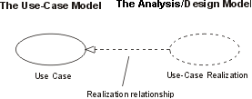

Slide 65
Use case realization – elements
Analysis class diagrams -Show the analysis classes that interact to realize the use case
Interaction diagrams- Show collaborations and interactions between specific instances that realize the use case – they are “snapshots” of the running system
Special requirements- The process of use case realization may well uncover new requirements specific to the use case – these must be captured
Use case refinement New information may be discovered during realization that means the original use case has to be updated

